Slide 1
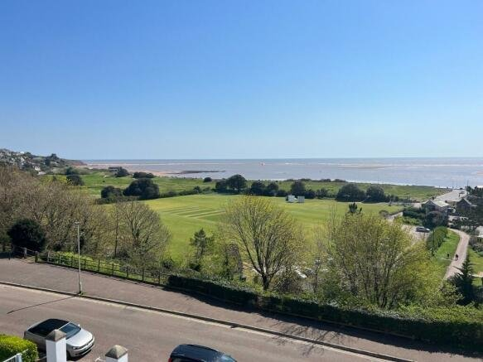
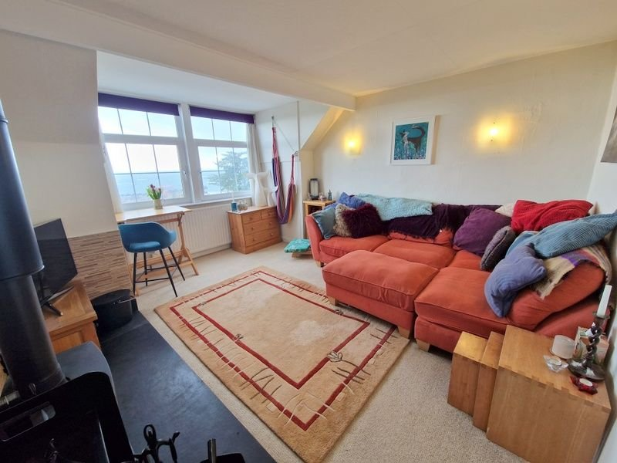
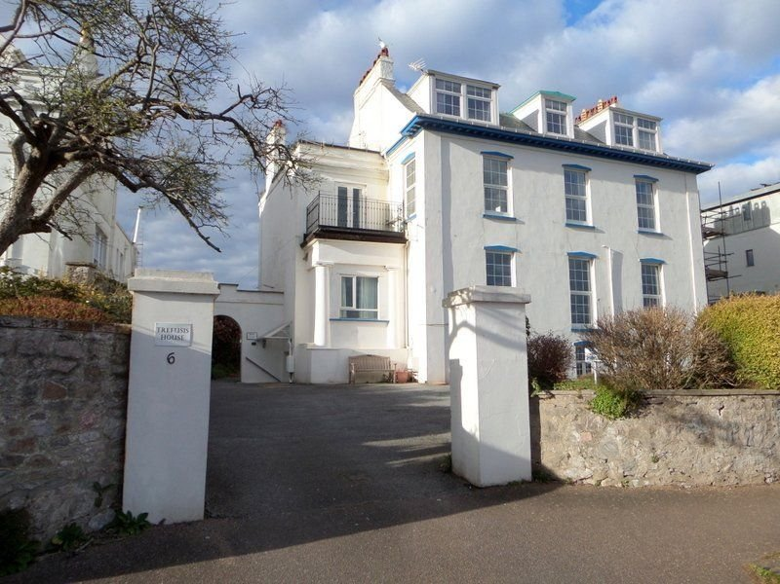
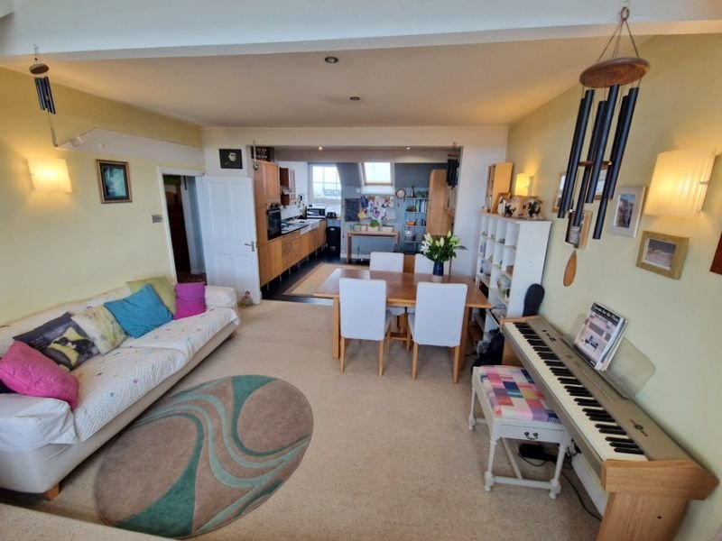
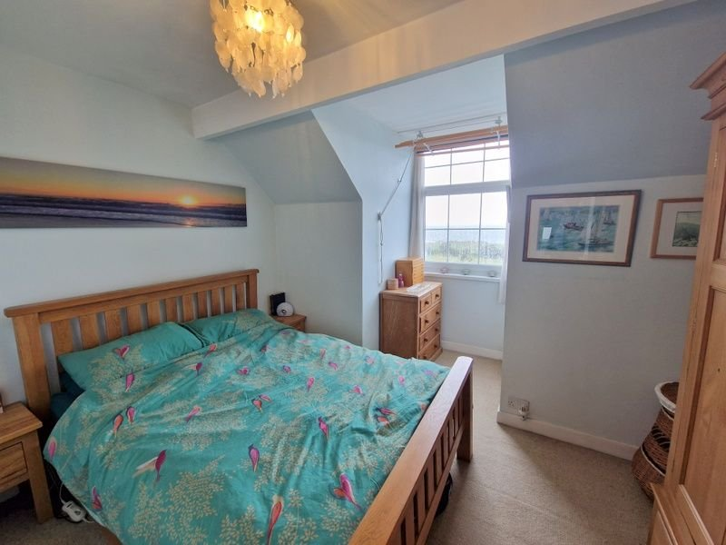
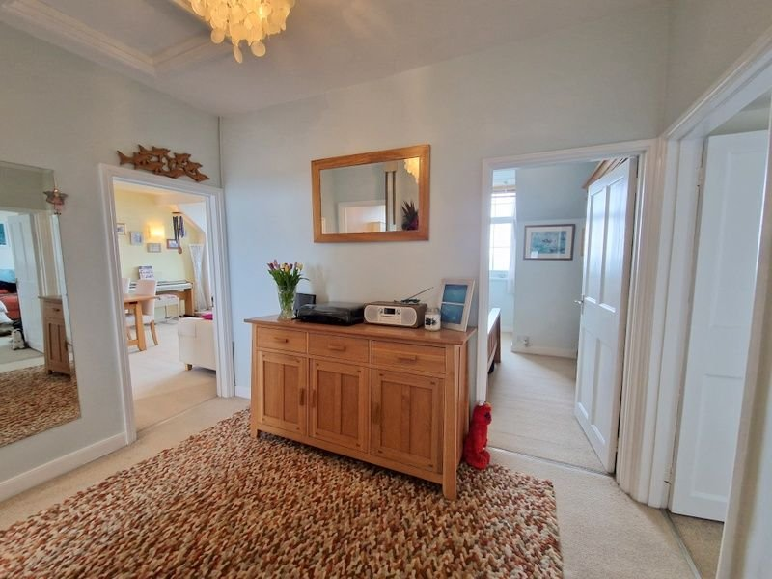
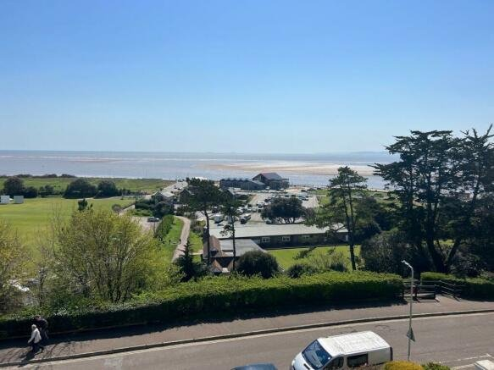
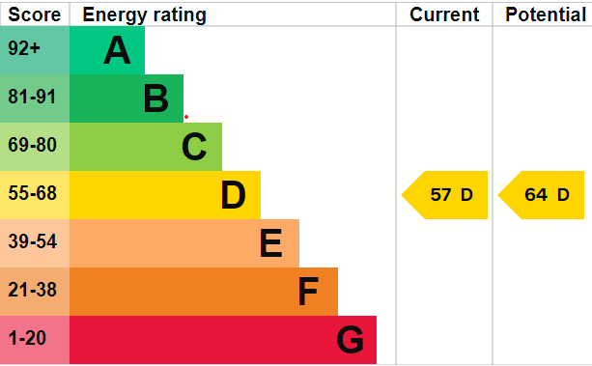
www.pennys.net
Flat 6 Trefusis House, Trefusis Terrace, Exmouth, EX8 2AX
GUIDE PRICE £399,950
TENURE Share of Freehold
A Spacious Top Floor Apartment With Stunning Sea And Coastal Views Located Just Off Exmouth’s Seafront With Garage, Parking And Communal Gardens.
Stunning Open Plan Stylish Kitchen And Dining Area * Sitting Room With Wood Burner * Two Bedrooms * Modern Shower Room/WC * Superb Permanent Or Holiday Home * Viewing Recommended *
Pennys Estate Agents Limited for themselves and for the vendor of this property whose agents they are give notice that:- (1) These particulars do not constitute any part of an offer or a contract. (2) All statements contained in these particulars are made without responsibility on the part of Pennys Estate Agents Limited. (3) None of the statements contained in these particulars are to be relied upon as a statement or representation of fact. (4) Any intending purchaser must satisfy himself/herself by inspection or otherwise as to the correctness of each of the statements contained in these particulars. (5) The vendor does not make or give and neither do Pennys Estate Agents Limited nor any person in their employment has any authority to make or give any representation or warranty whatever in relation to this property.
PENNYS ESTATE AGENTS
2 Rolle House, Rolle Street, Exmouth, Devon, EX8 2SN
Tel: 01395 264111 EMail: help@pennys.net

Slide 2
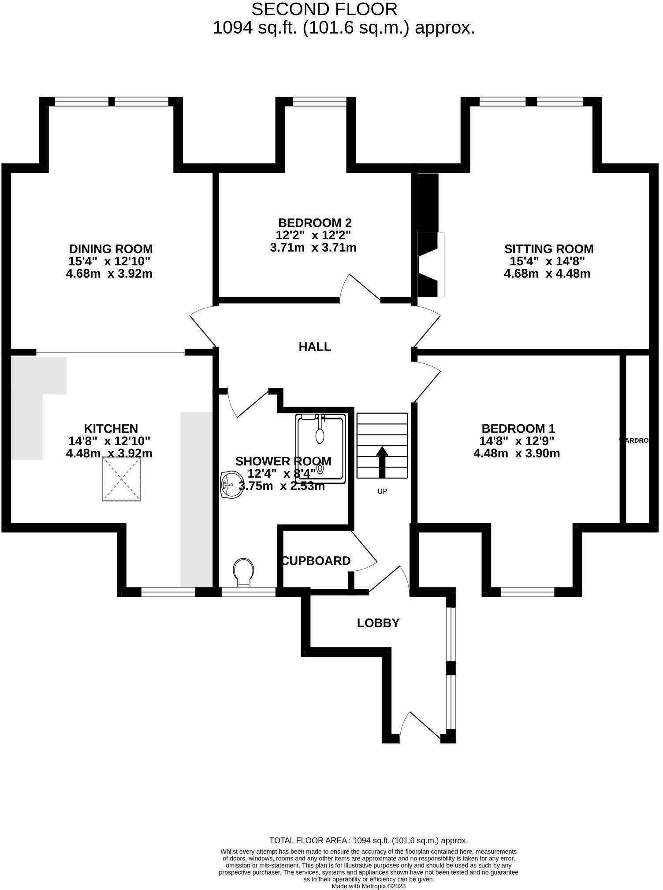
Flat 6 Trefusis House, Trefusis Terrace, Exmouth, EX8 2AX
THE ACCOMMODATION COMPRISES:
Communal entrance door with stairs leading up to the second floor.
SECOND FLOOR: Private entrance door to the:
ENTRANCE LOBBY: Two double glazed windows to the side with views across the Estuary. Glazed door leading through to the..
HALLWAY: Storage cupboards (one housing space and plumbing for the washing machine). Radiator. Steps rising to…
RECEPTION HALL: Hatch to roof space. Doors leading off to:
OPEN PLAN KITCHEN/DINING ROOM:
KITCHEN/AREA: 14’8” (4.47m) x 12’10” (3.91m): The kitchen is fitted with Oak front units with granite worktop surfaces with matching upstands. Inset twin induction and twin gas hob. Belfast sink with double bowl and mixer tap. Integrated dishwasher. Built-in oven, fridge and freezer. Pull out larder units and corner display shelving. Matching wall mounted cupboards with under lighting and stainless steel cooker hood. Downlighters. Double glazed window to the rear with views across the Exe Estuary. Double Glazed Velux windows. Radiator.
DINING AREA: 4.67m x 3.91m (15'4" x 12'10"): Two large fully opening double glazed windows to the front of the building with raised floor to take full advantage of the views across the Cricket Ground, Exmouth Beach, the sea and Dawlish Warren. Radiator.
SITTING ROOM: 4.67m x 4.47m (15'4" x 14'8"): Two large fully opening double glazed windows to the front of the building, again with views across the Cricket Ground, Exmouth Beach, the sea and Dawlish Warren. Radiator. Woodburner Stove with tiled surround and Welsh slate hearth.
BEDROOM 1: 14’8” x 12’9” (4.47m x 3.89m): Double glazed window to rear with views to the Exe Estuary. Two built-in double wardrobes. Eaves storage. Radiator.
BEDROOM 2: 12’2” x 12’2” (3.71m x 3.71m): Double glazed window to front of property with beautiful views towards Dawlish Warren. Radiator.
SHOWER ROOM/WC: 12’4” x 8’4” ( 3.76m x 2.54m): Modern white suite comprising fully tiled walk-in shower with built-in shower unit. Low level WC. Pedestal wash hand basin with mixer tap. Walls in full tiled surround. Tiled floor. Double glazed window to rear with pattern glass. Chrome runged radiator. Fitted mirrored medicine cabinet. Downlighters. Extractor fan.
OUTSIDE: The property benefits from COMMUNAL FRONT & REAR GARDENS, and a PARKING SPACE in front of the garage. There is also OFF ROAD VISITORS PARKING and a PRIVATE LOCKABLE SHED.
MORTGAGE ASSISTANCE: We are pleased to recommend Meredith Morgan Taylor, who would be pleased to help irrelevant of which estate agent you finally buy through. For a free initial, no obligation chat please contact us on 01395 264111 to arrange an appointment.
FLOOR PLAN:

